Slide 1

Stocks

Slide 2
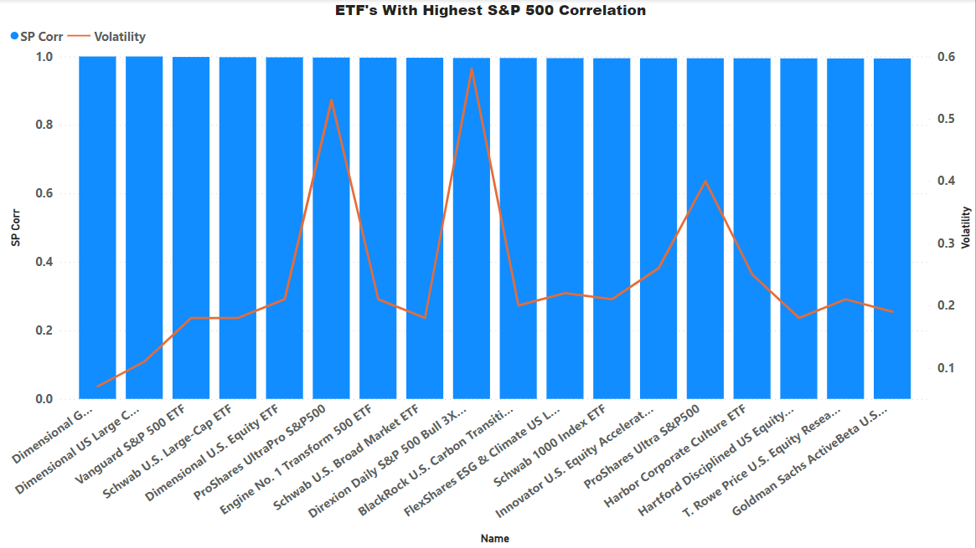
QUICK Lesson (SP 500)
Compare to other long term indexes and look at regression

Slide 3
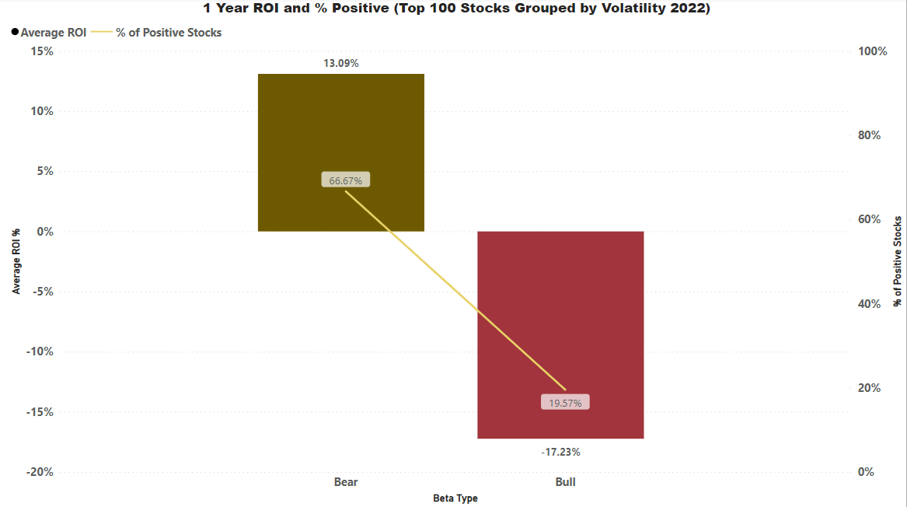


Beta (Bear Vs Bull)

Slide 4
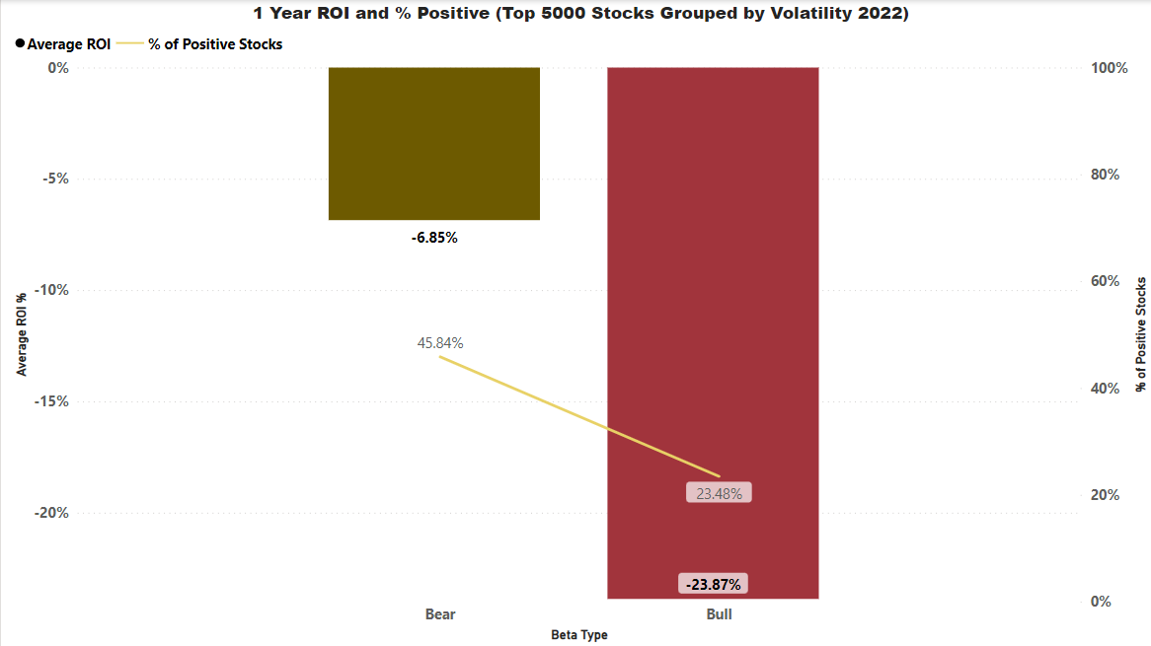
Beta (Bear Vs Bull)

Slide 5
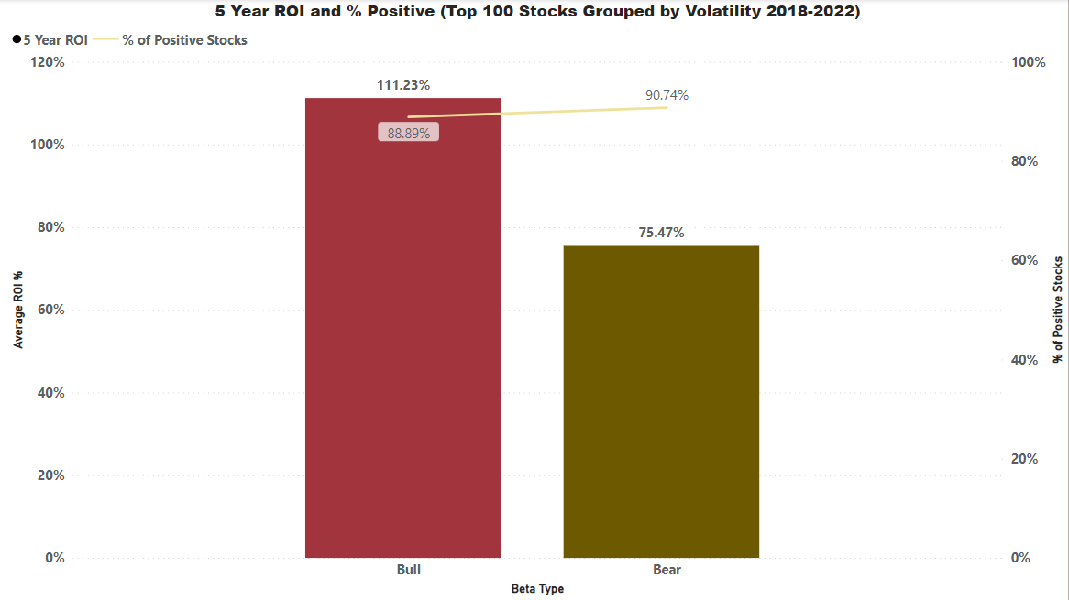
Beta (Bear Vs Bull)

Slide 6
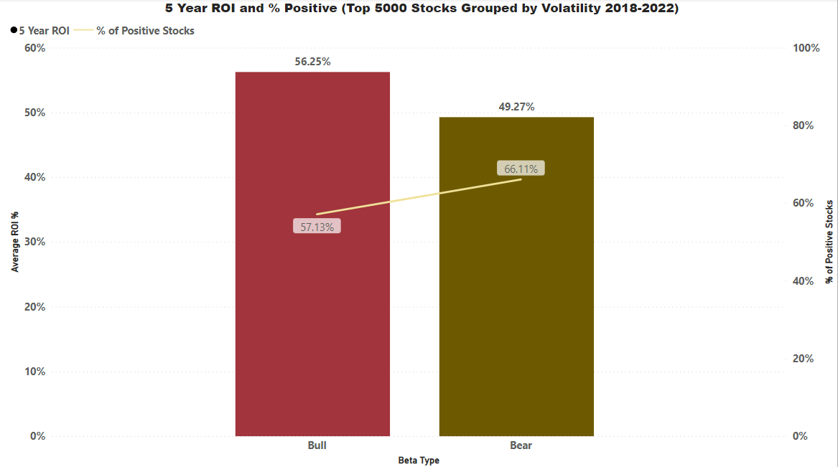
Beta (Bear Vs Bull)

Slide 7
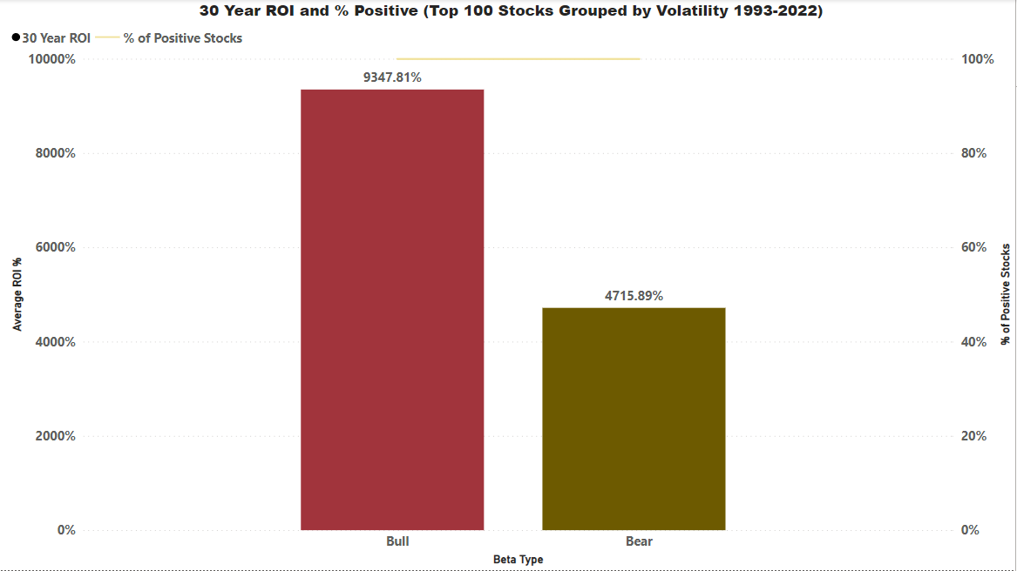
Beta (Bear Vs Bull)

Slide 8
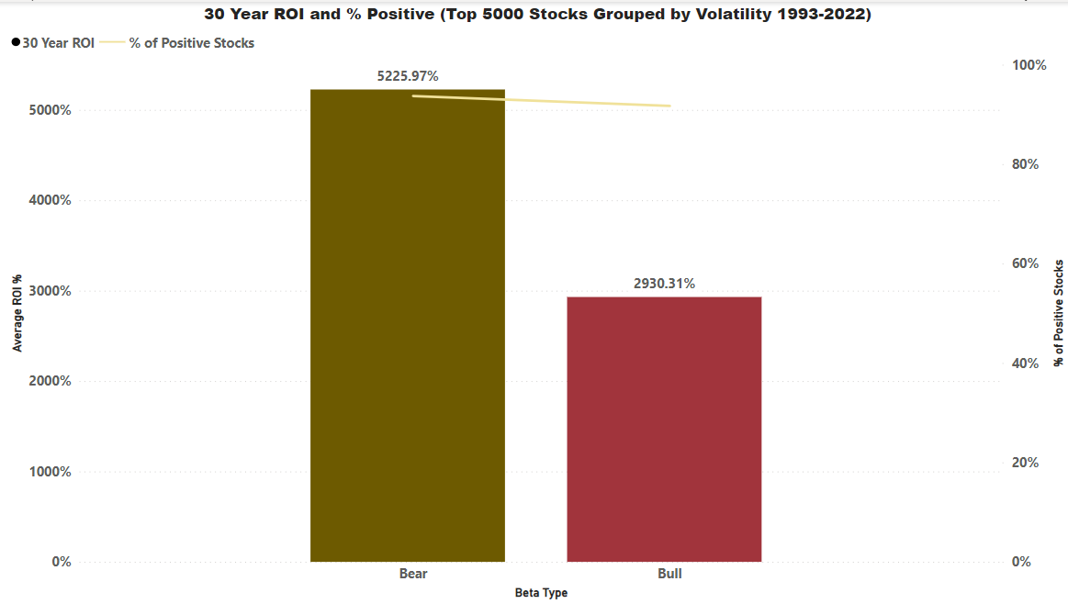
Beta (Bear Vs Bull)

Slide 9
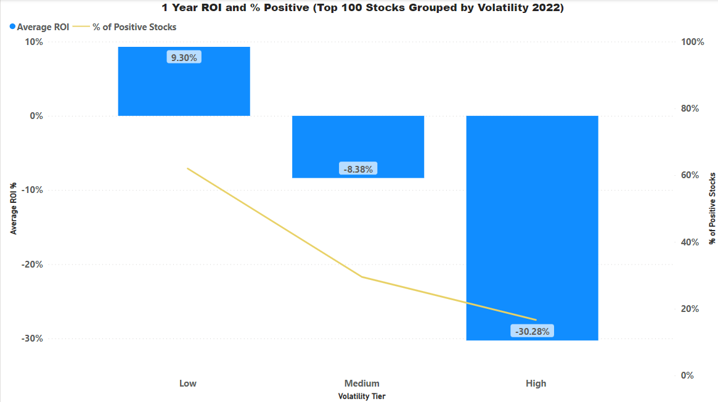
Volatility

Slide 10
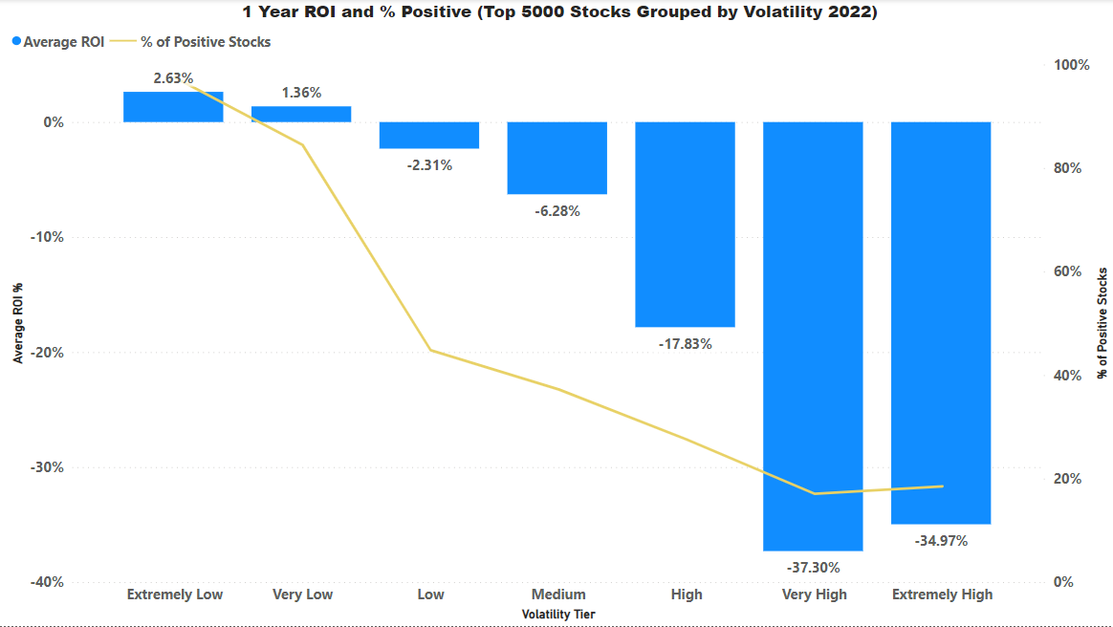
Volatility

Slide 11
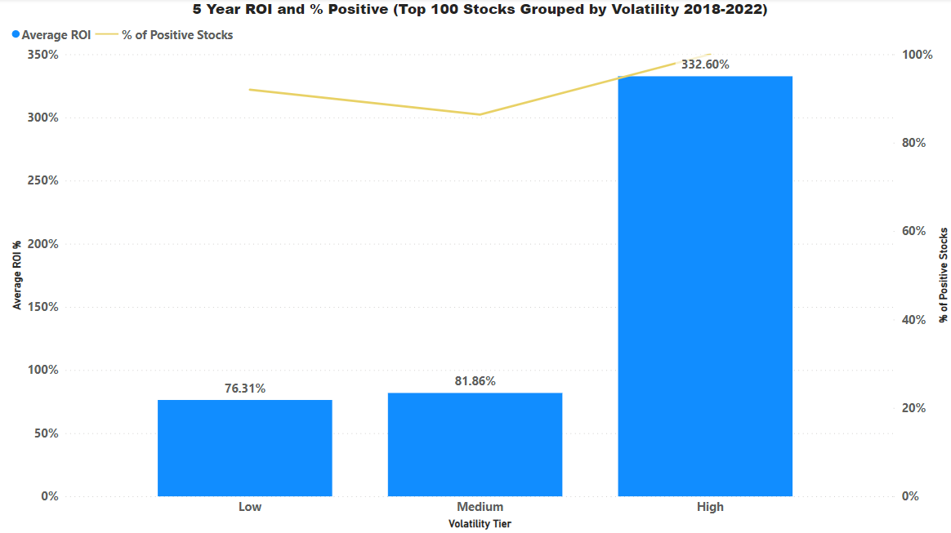
Volatility

Slide 12
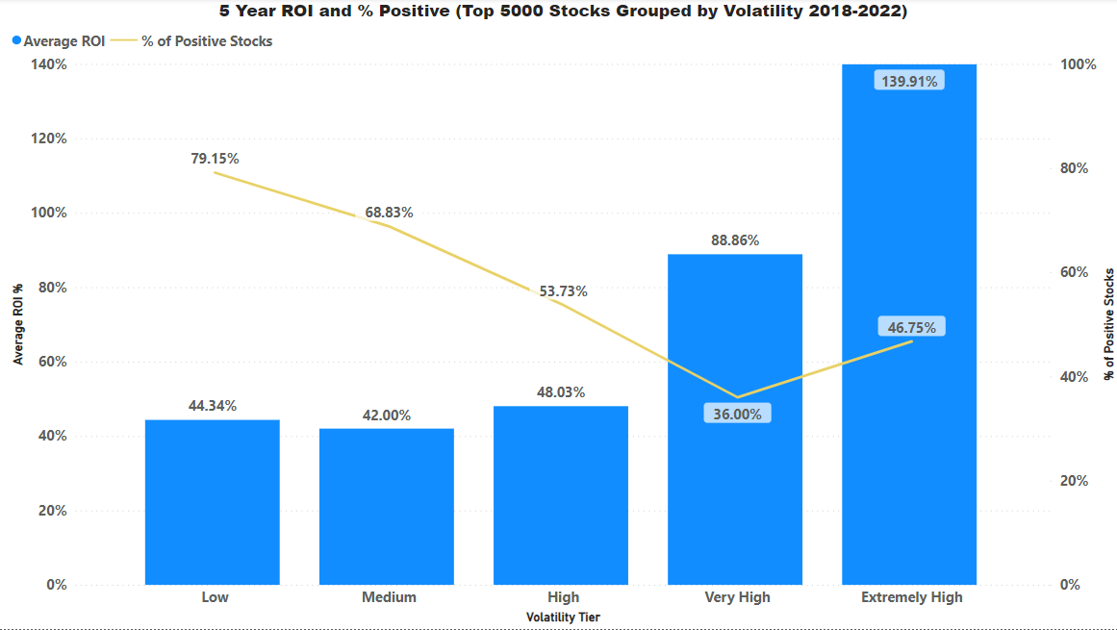
Volatility

Slide 13
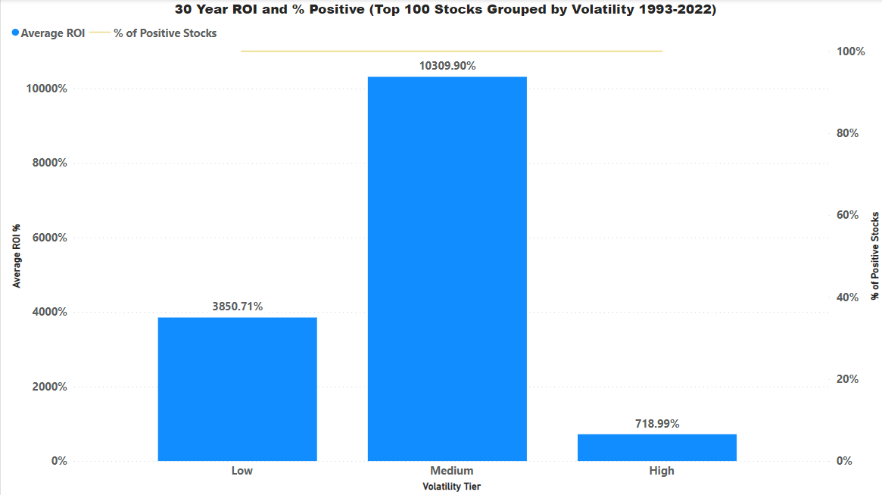
Volatility

Slide 14
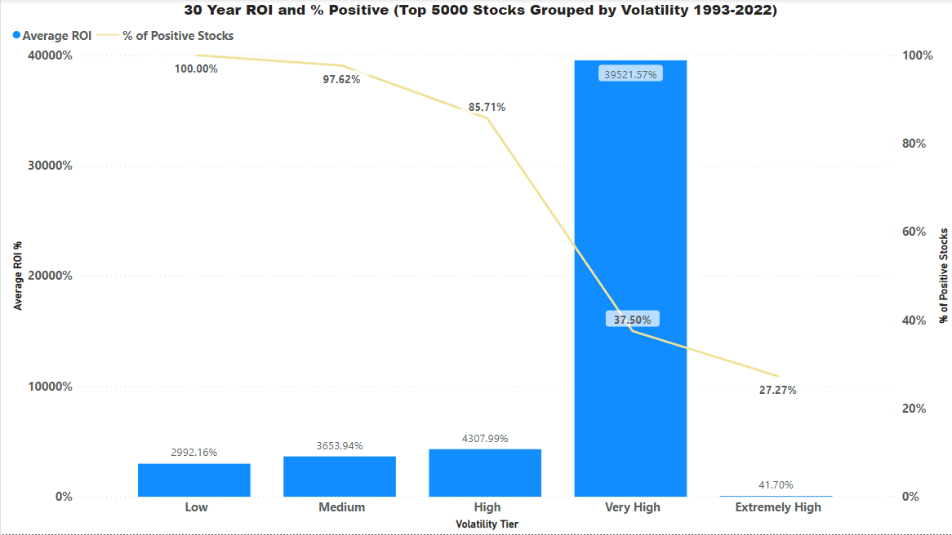
Volatility

Slide 15
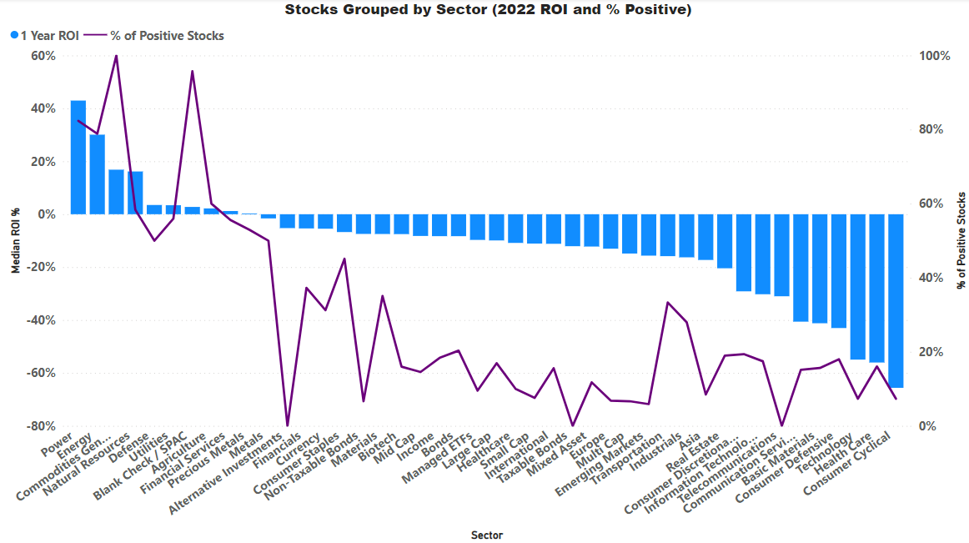
Sector

Slide 16
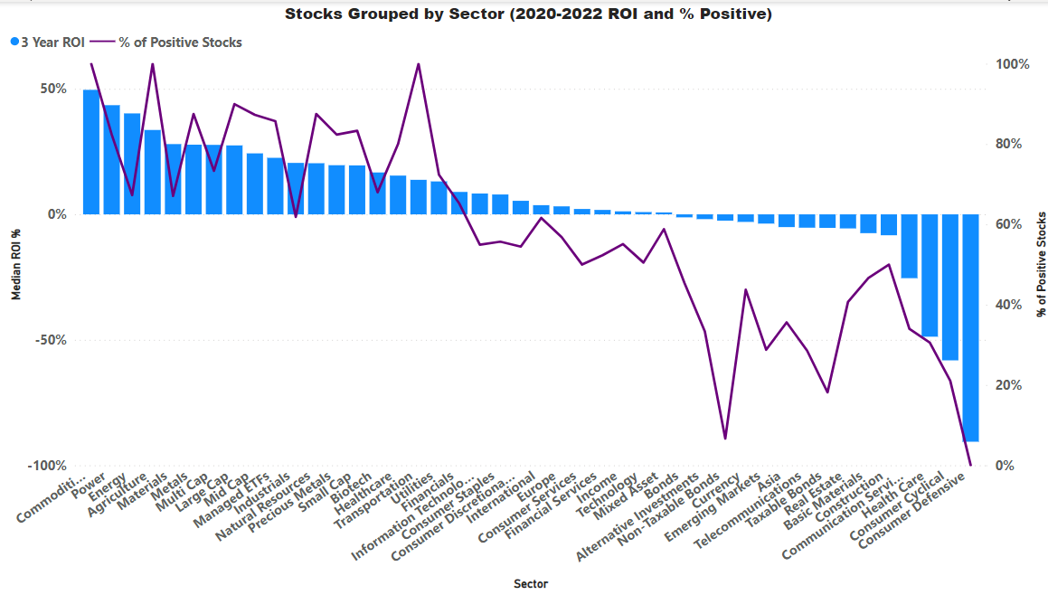
Sector

Slide 17
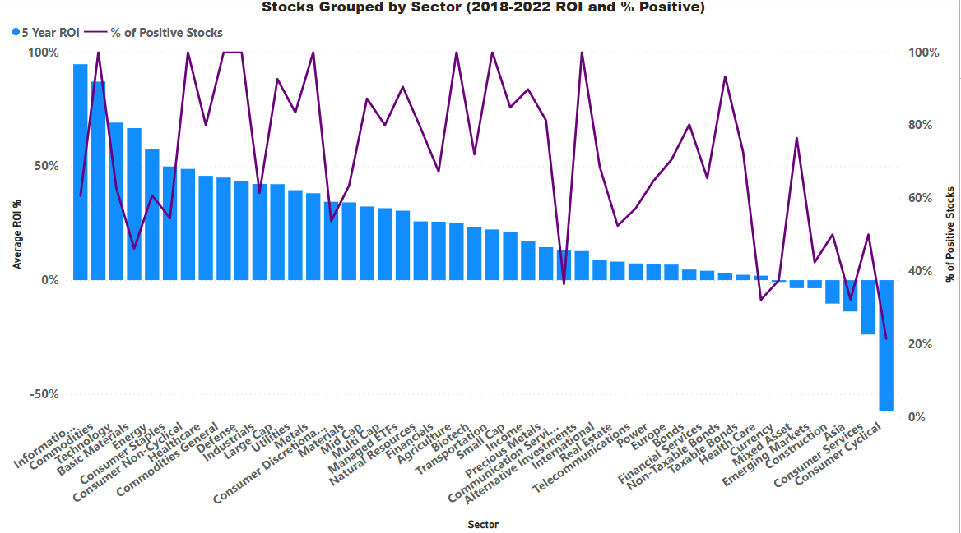
Sector

Slide 18
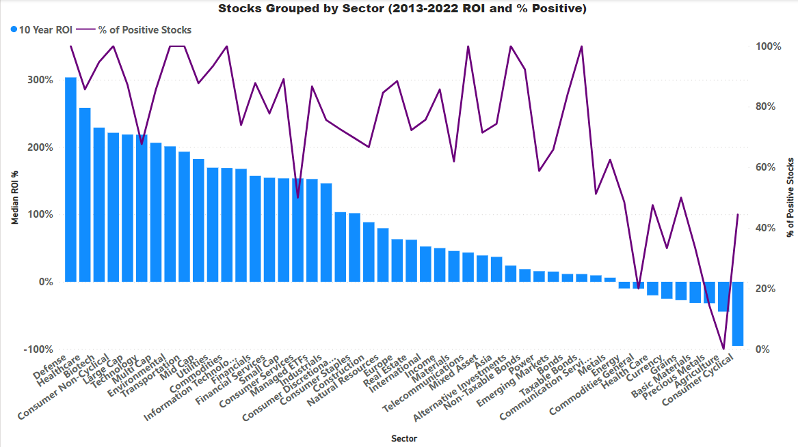
Sector

Slide 19
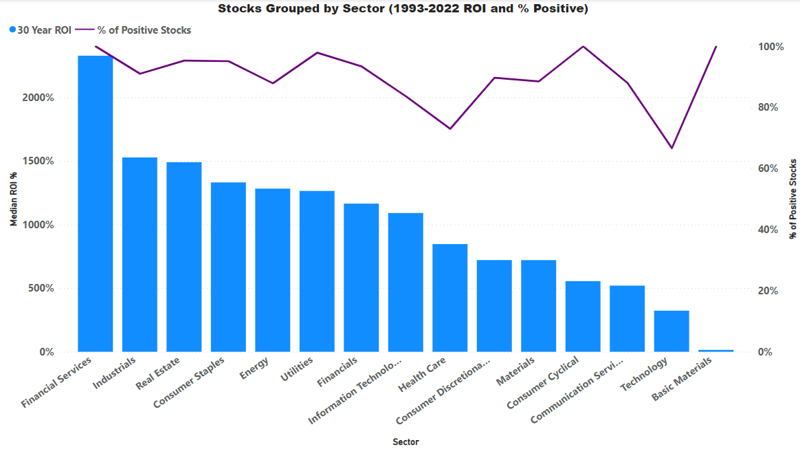
Sector

Slide 20
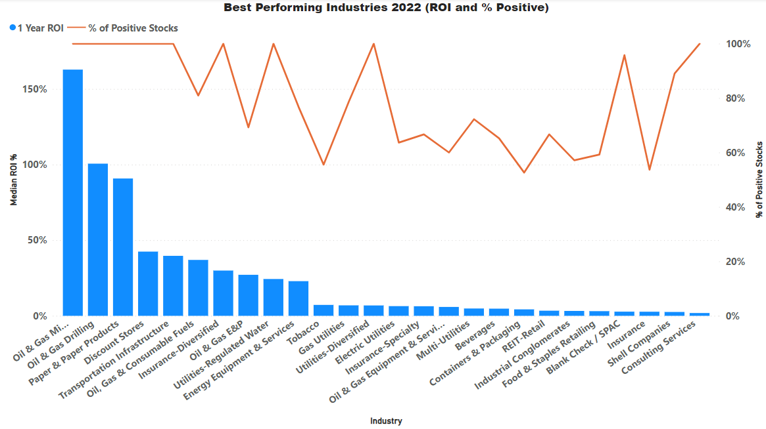
Industry

Slide 21
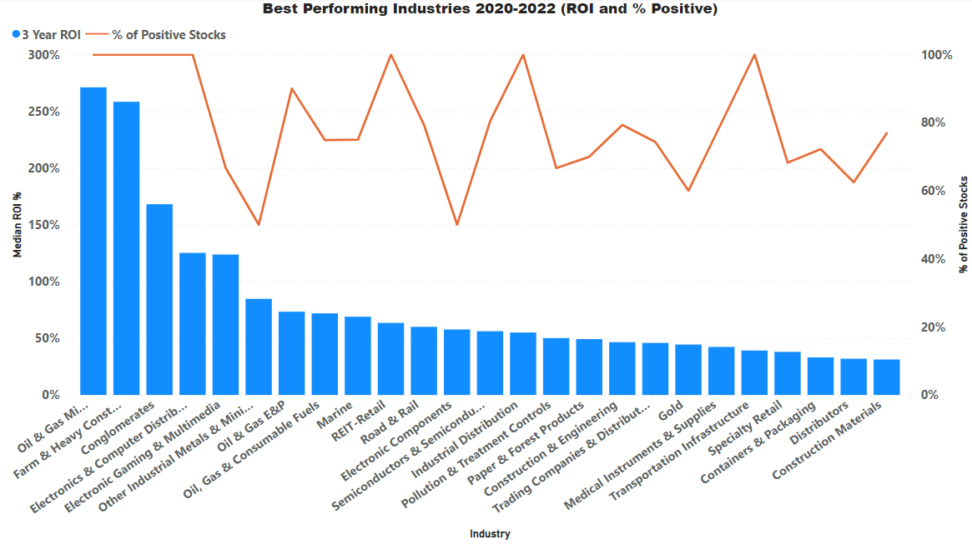
Industry

Slide 22
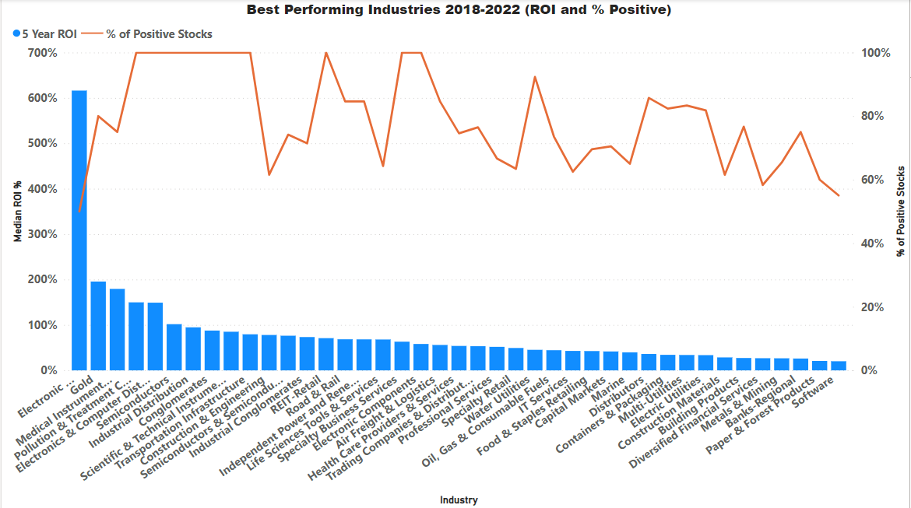
Industry

Slide 23
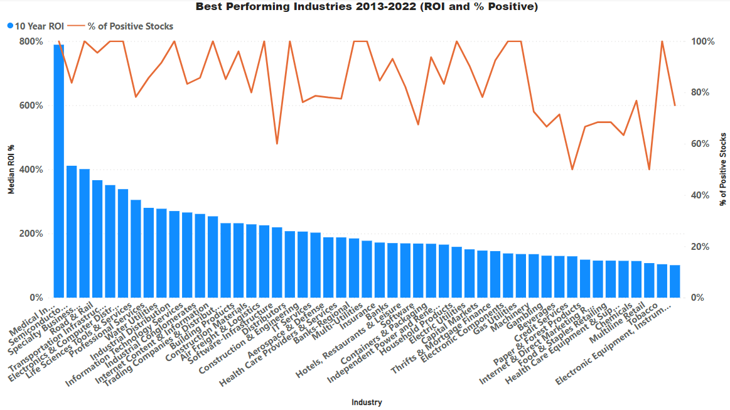
Industry

Slide 24
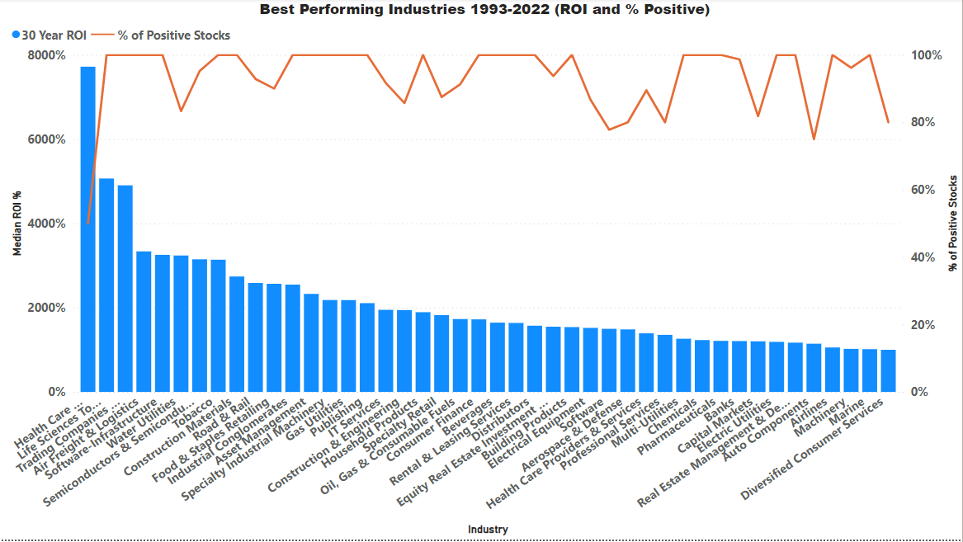
Industry

Slide 25
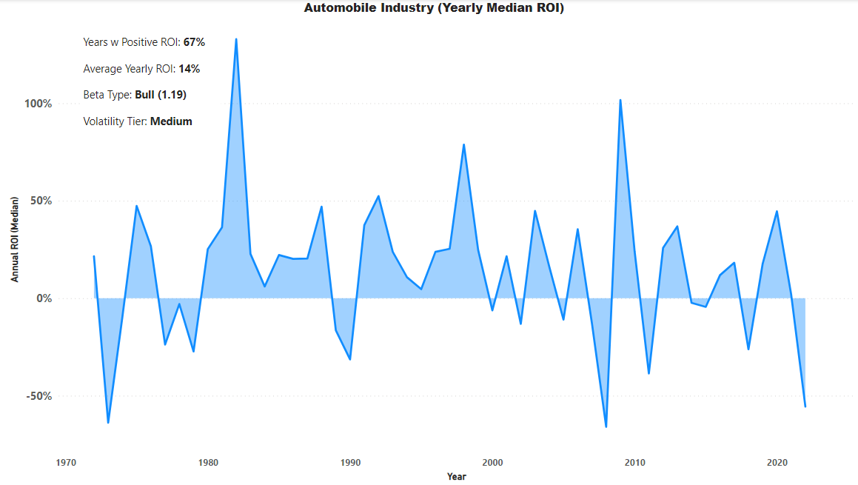
Industry

Slide 26
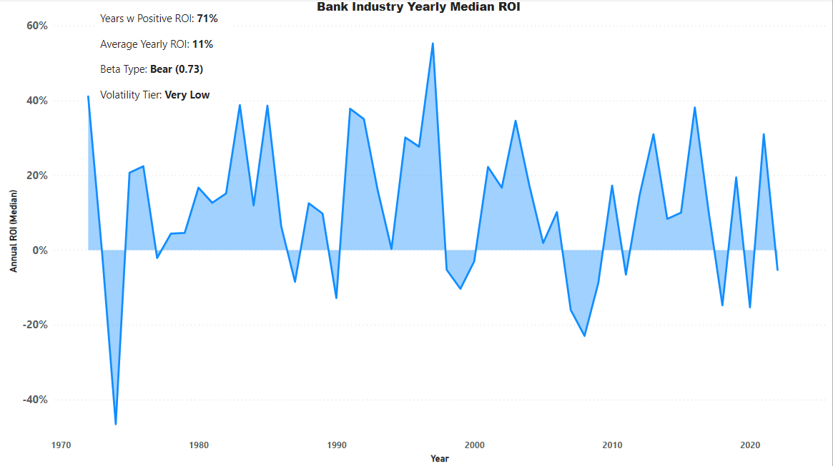
Industry

Slide 27
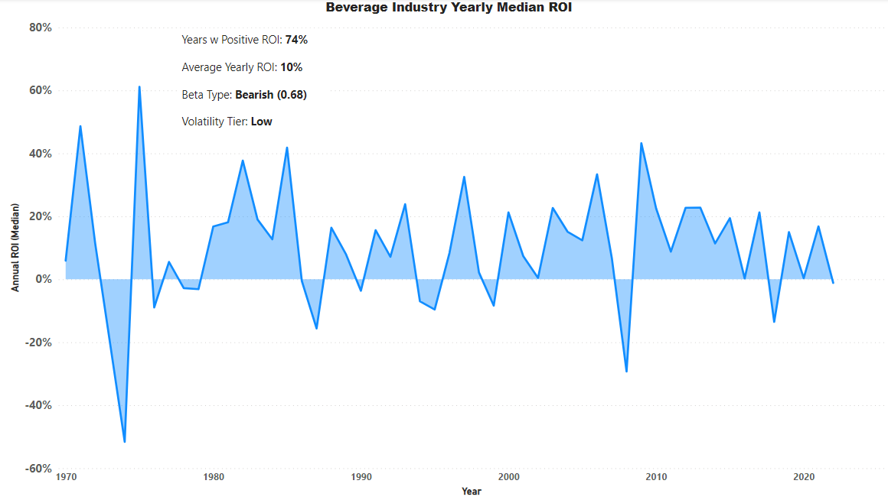
Industry

Slide 28
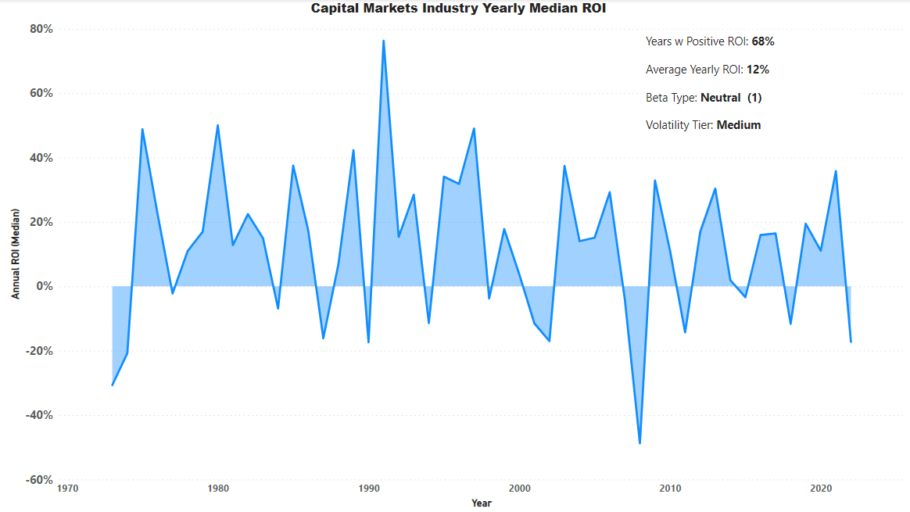
Industry

Slide 29
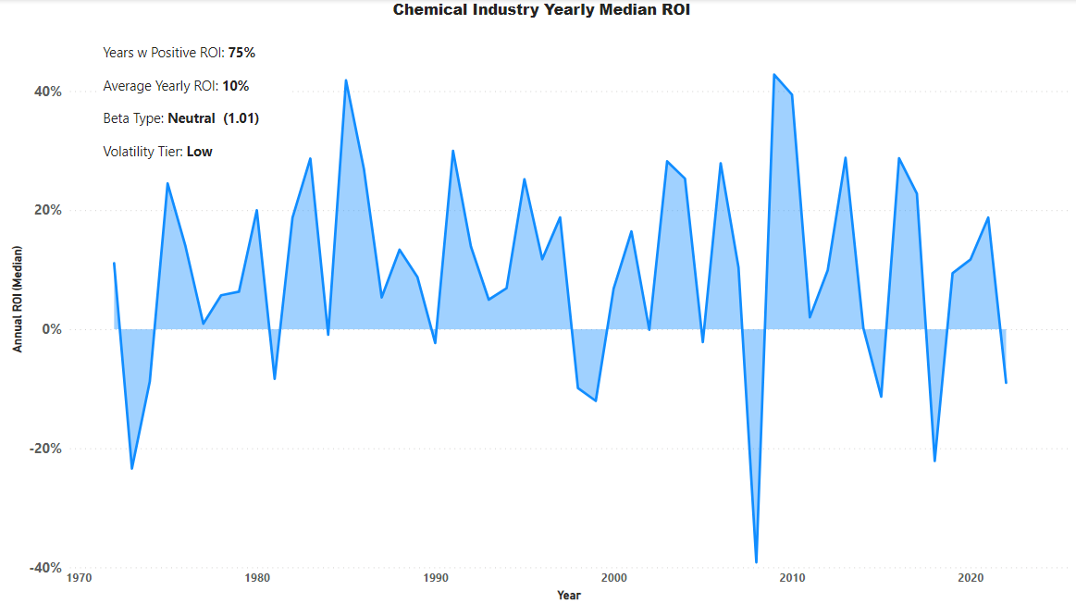
Industry

Slide 30
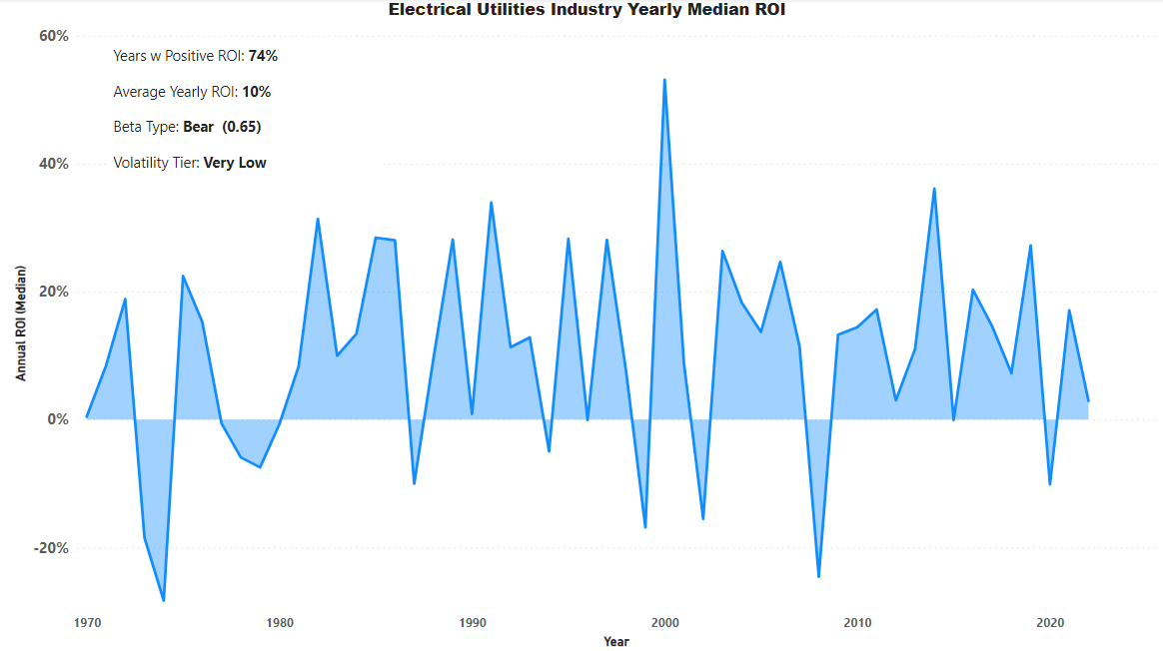
Industry

Slide 31
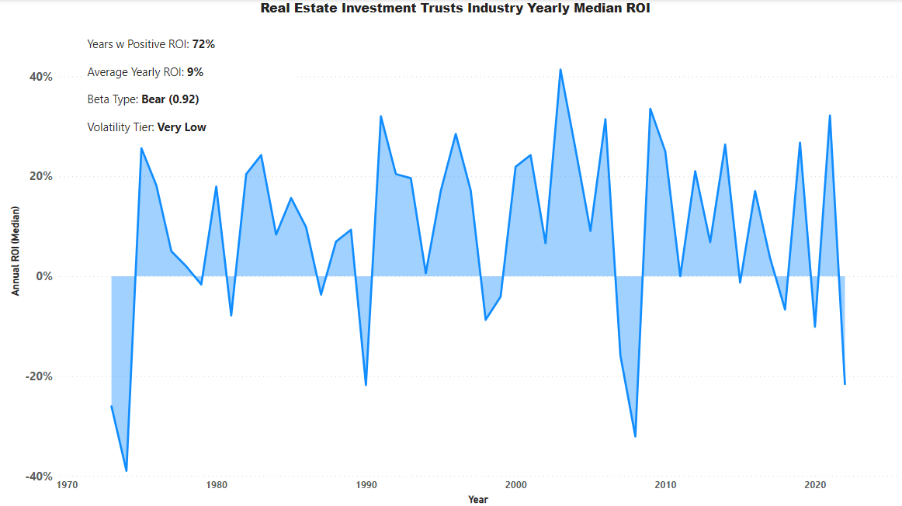
Industry

Slide 32
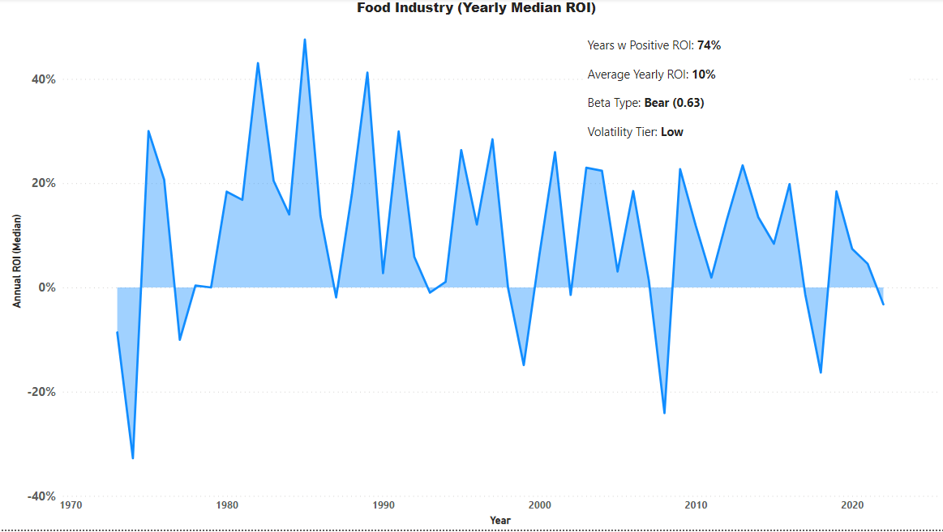
Industry

Slide 33
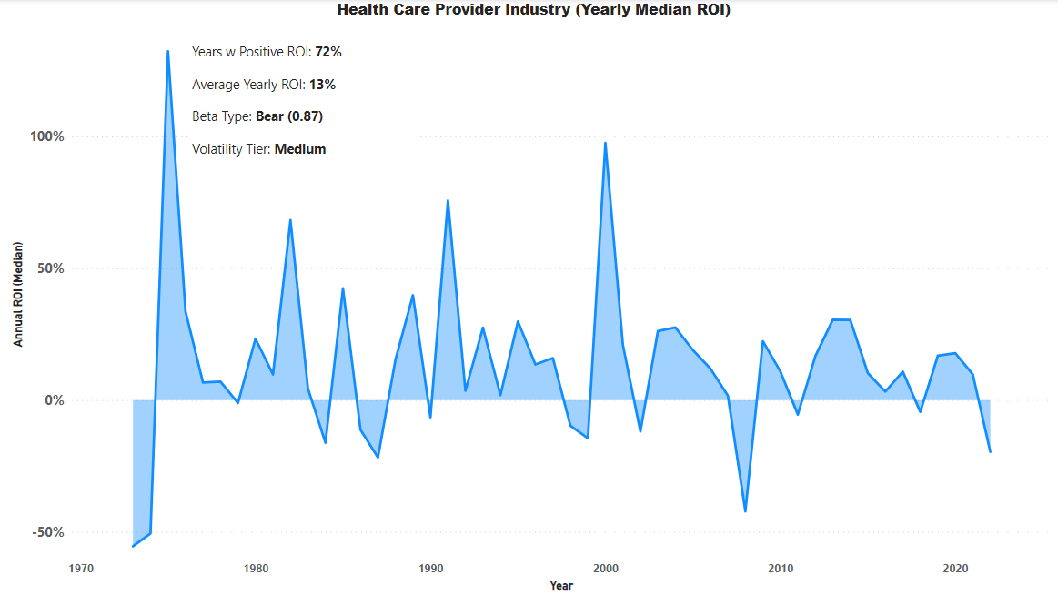
Industry

Slide 34
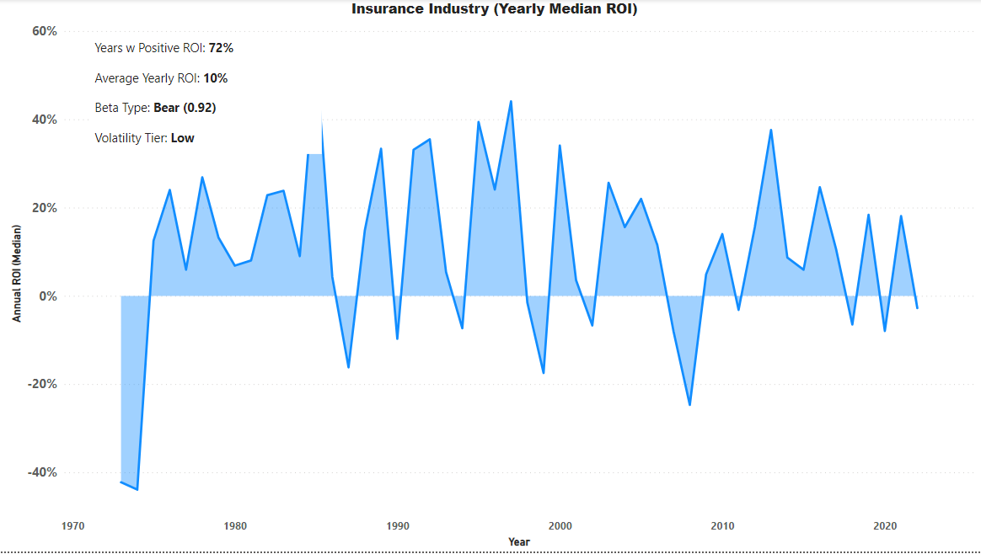
Industry

Slide 35
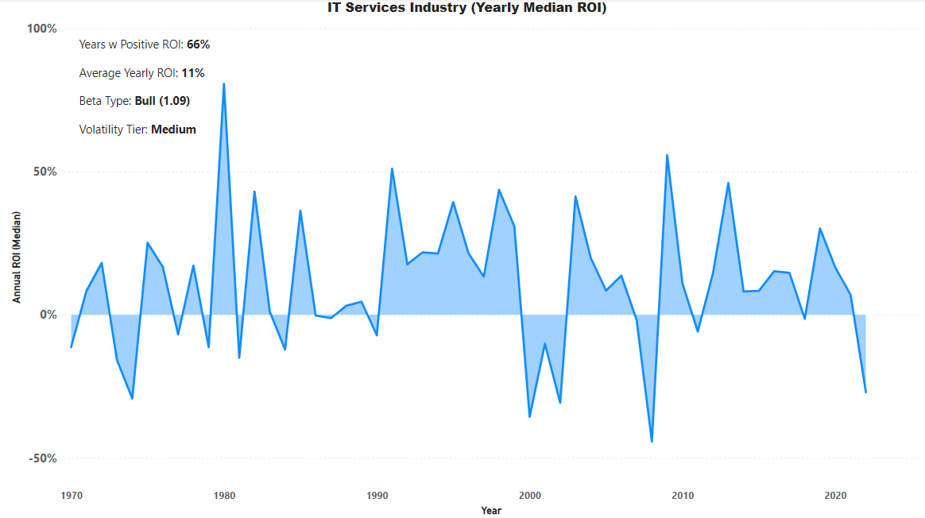
Industry

Slide 36
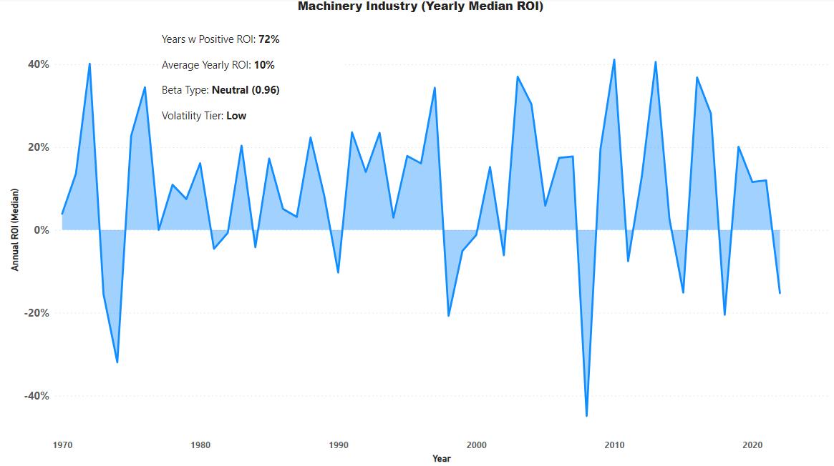
Industry

Slide 37
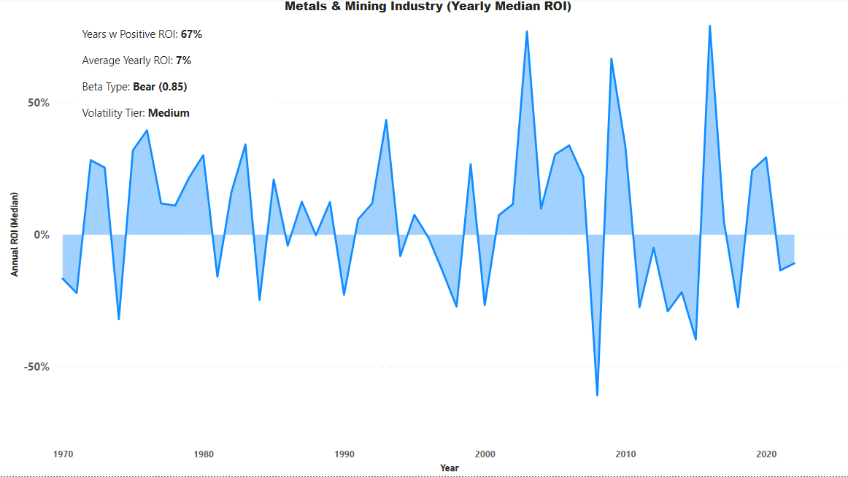
Industry

Slide 38
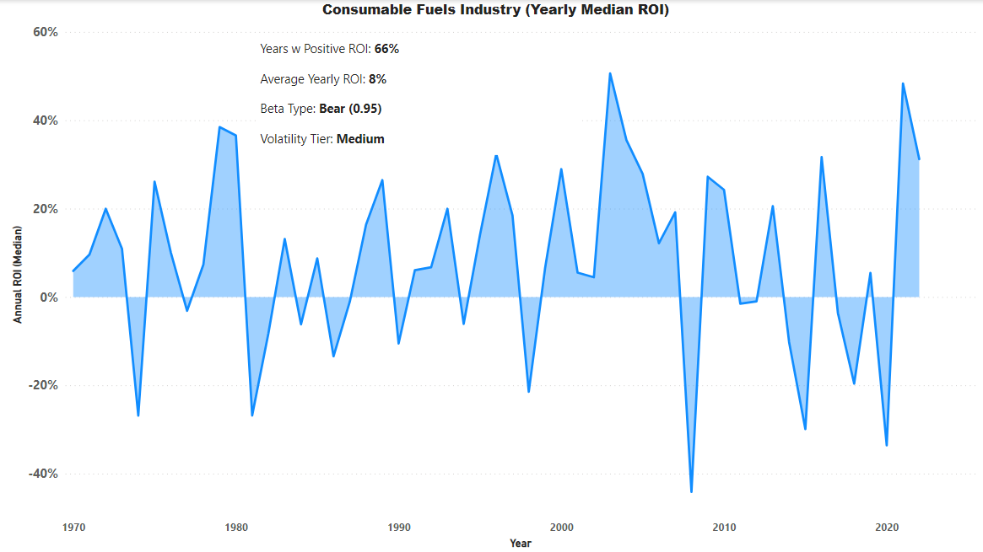
Industry

Slide 39
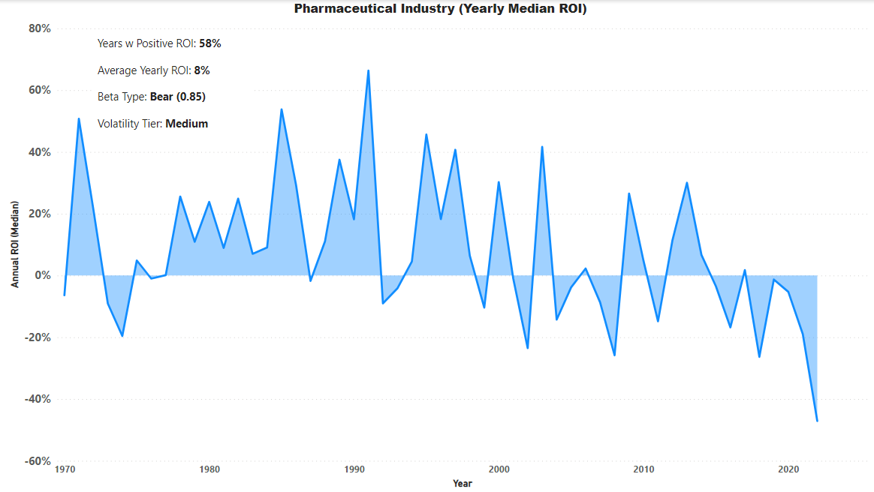
Industry

Slide 40
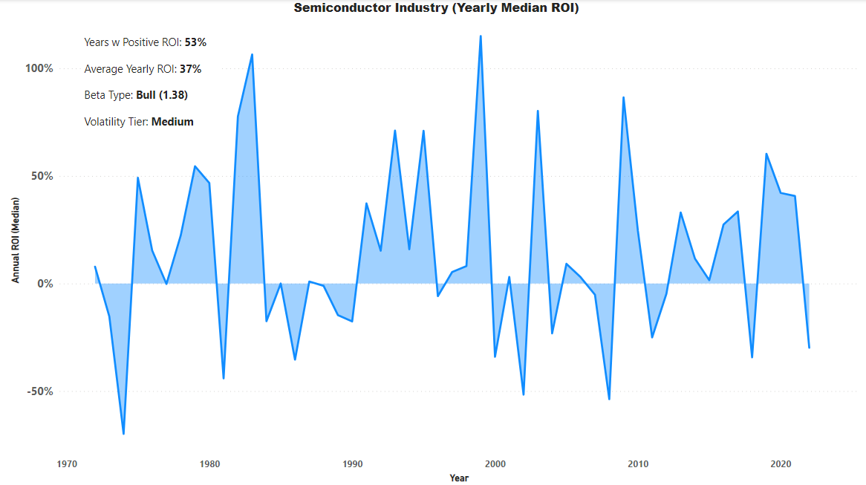
Industry

Slide 41
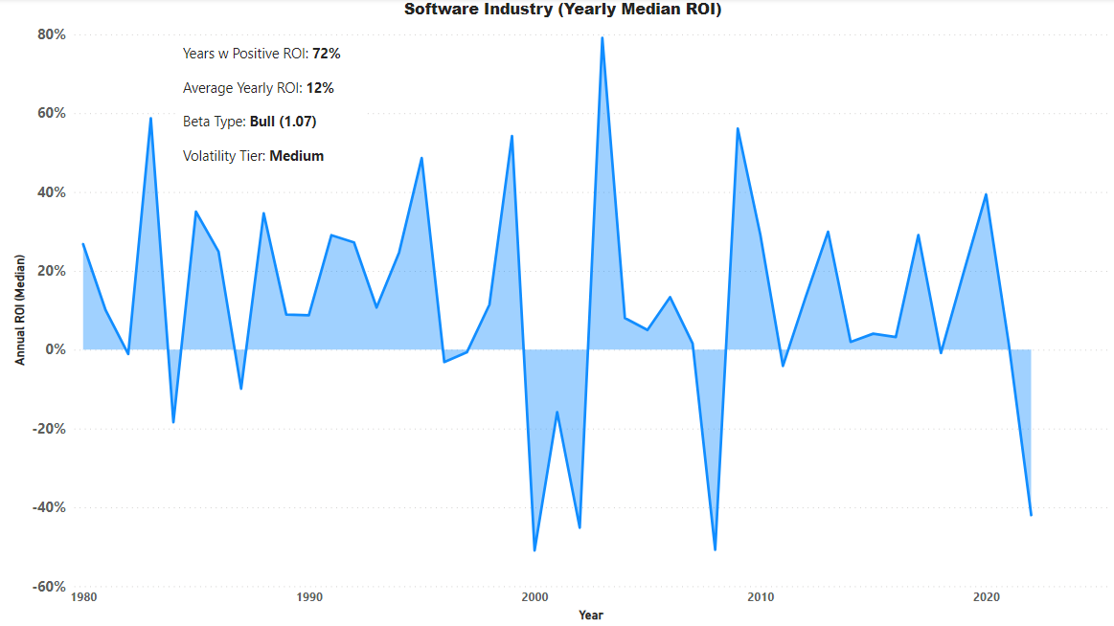
Industry

Slide 42
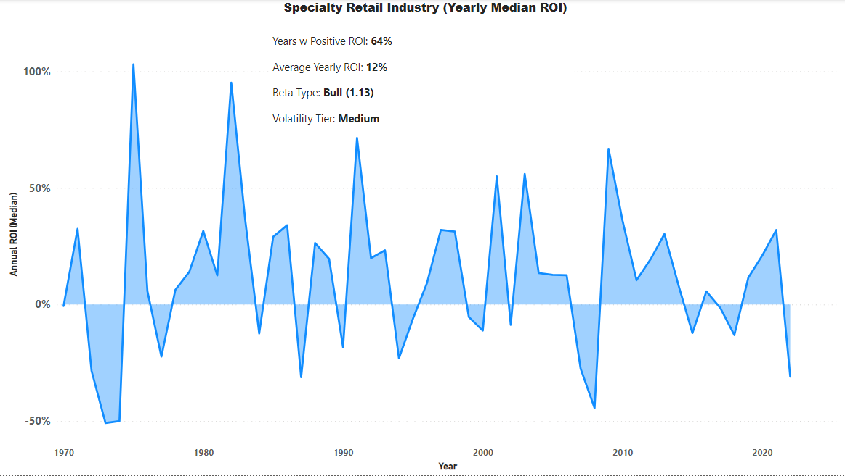
Industry

Slide 43
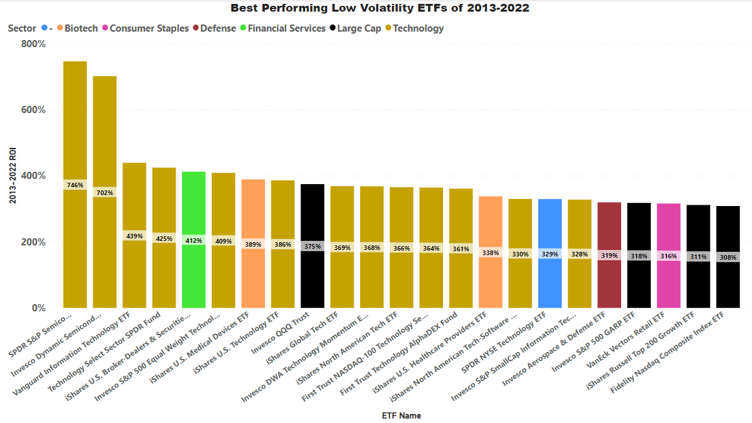
ETF’s

Slide 44
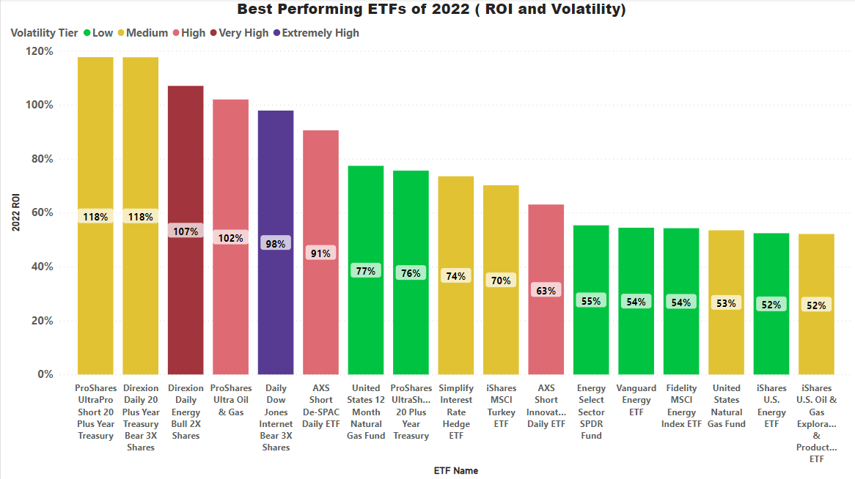
ETF’s

Slide 45
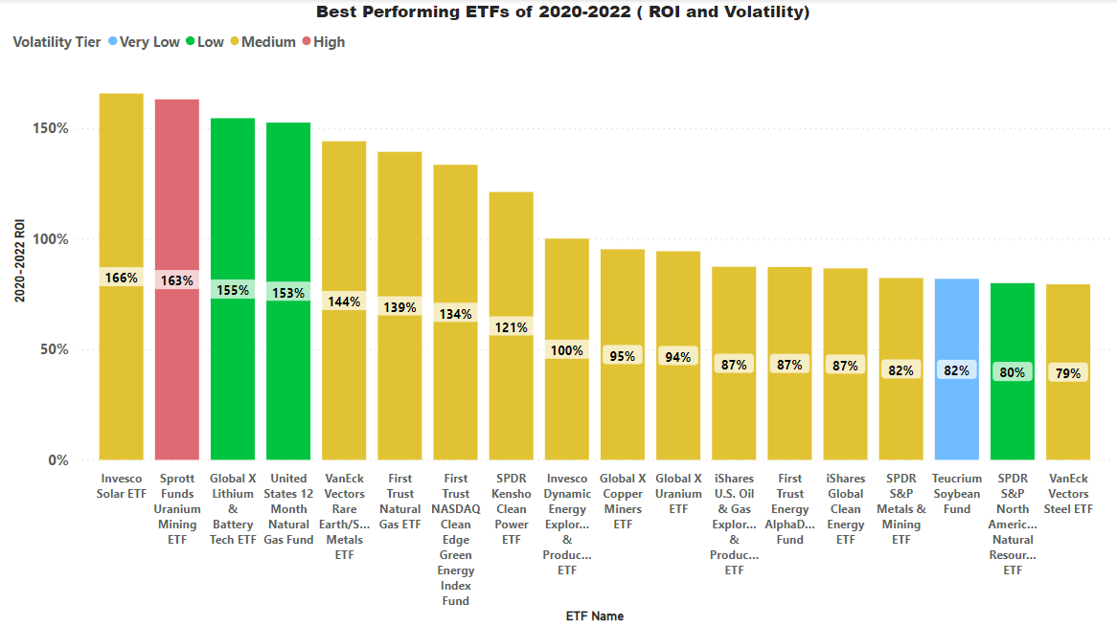
ETF’s

Slide 46
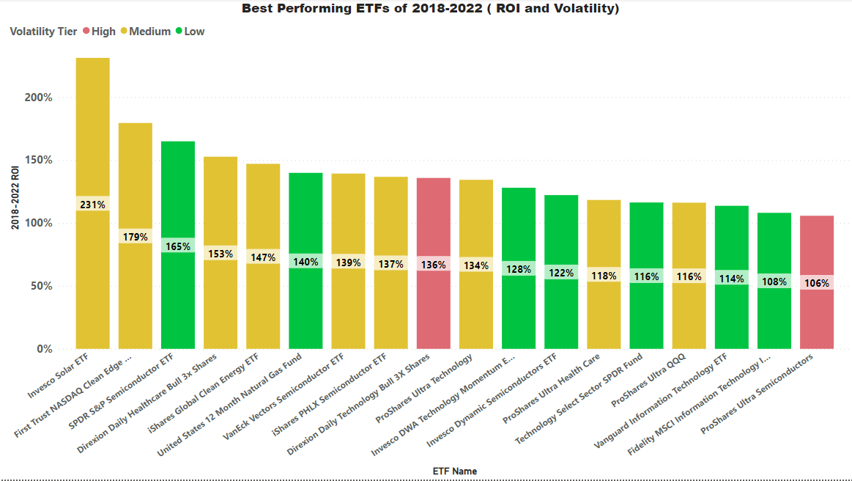
ETF’s

Slide 47
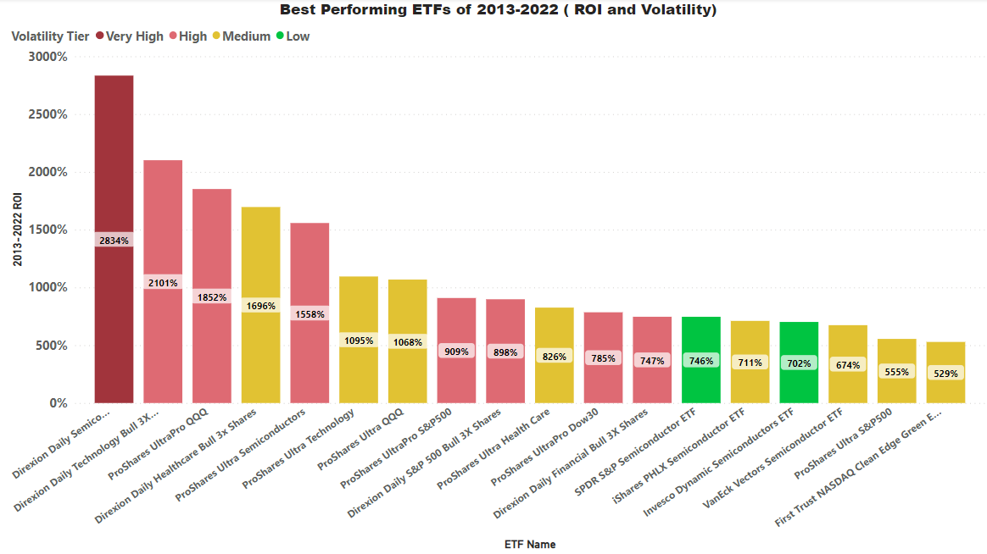
ETF’s
Add best performing low vol etfs

Slide 48
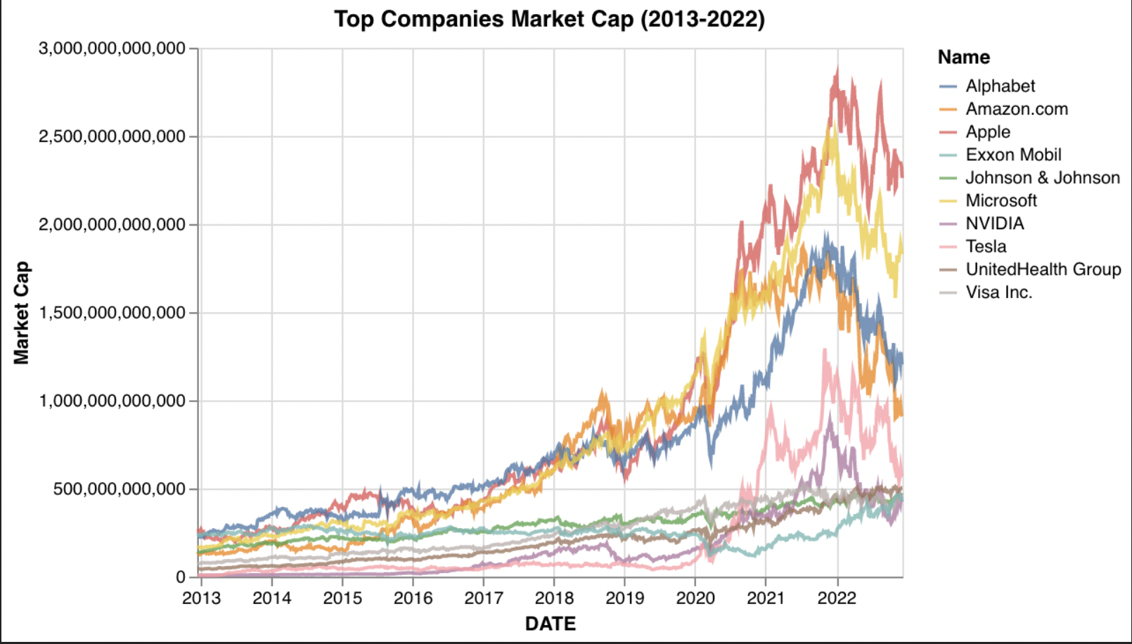
Stock’s

Slide 49
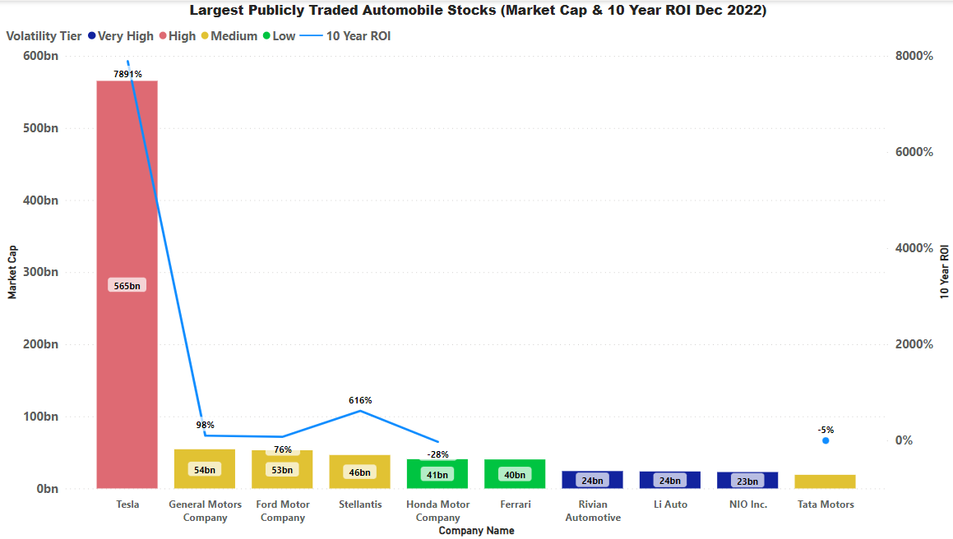
Stock’s

Slide 50
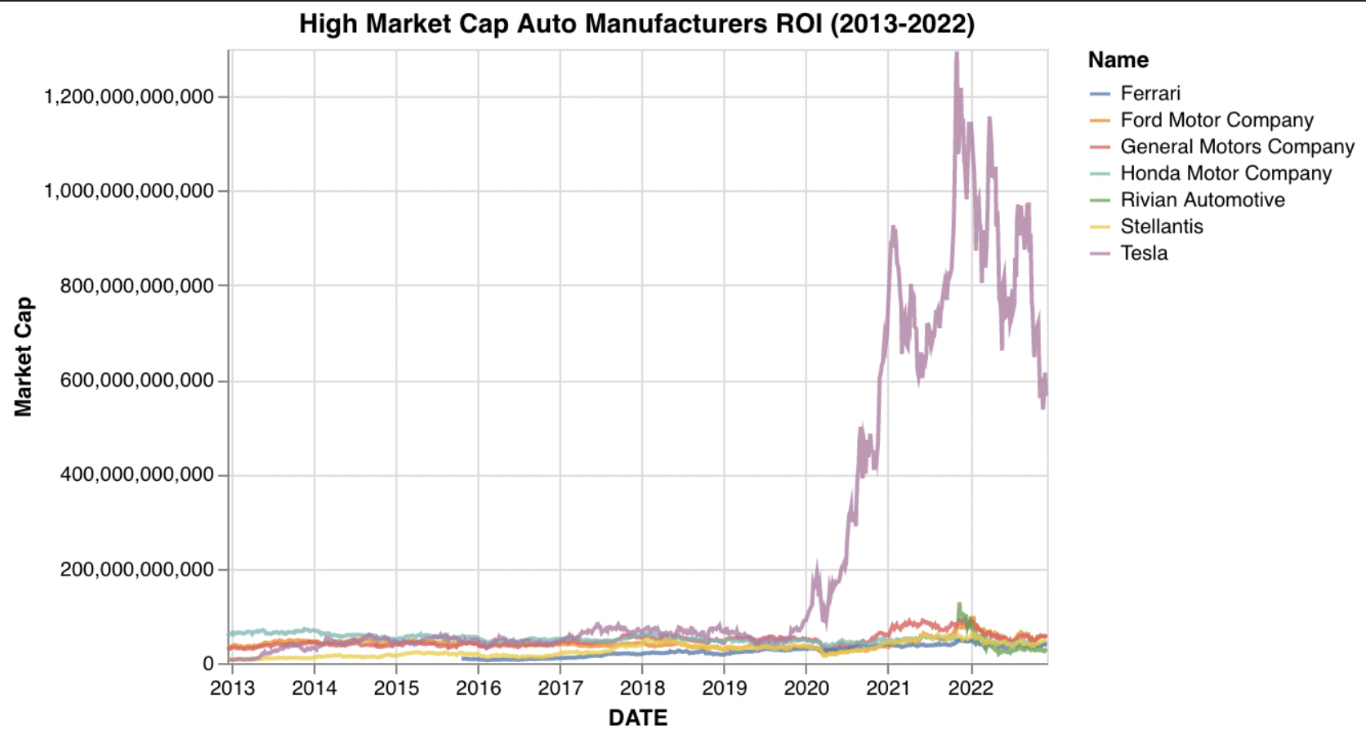
Stock’s

Slide 51
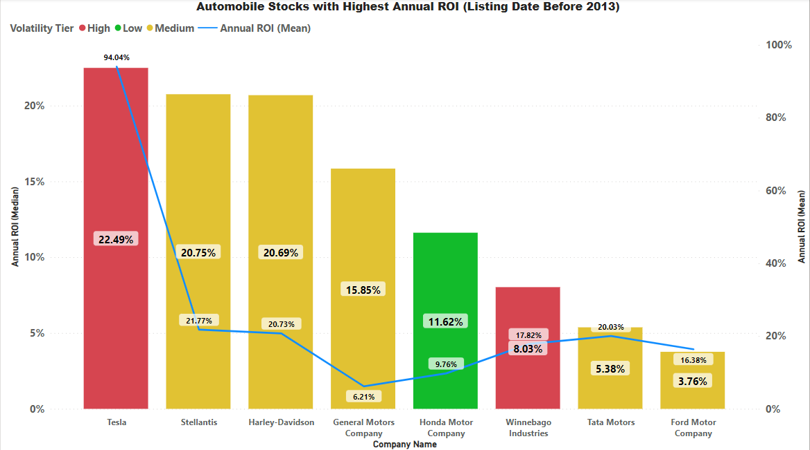
Stock’s

Slide 52

Stock’s

Slide 53

Stock’s

Slide 54

Stock’s

Slide 55

Stock’s

Slide 56

Stock’s

Slide 57

Stock’s

Slide 58

Stock’s

Slide 59

Stock’s

Slide 60

Stock’s

Slide 61

Stock’s

Slide 62

Stock’s

Slide 63

Stock’s

Slide 64

Stock’s

Slide 65

Stock’s

Slide 66

Stock’s

Slide 67

Stock’s

Slide 68

Stock’s

Slide 69

Stock’s

Slide 70

Stock’s

Slide 71

Stock’s

Slide 72

Stock’s

Slide 73

Stock’s

Slide 74

Stock’s

Slide 75

Stock’s

Slide 76

Stock’s

Slide 77

Stock’s

Slide 78

Stock’s

Slide 79

Stock’s

Slide 80

Stock’s

Slide 81

Stock’s

Slide 82

Stock’s

Slide 83

Stock’s

Slide 84

Stock’s

Slide 85

Stock’s

Slide 86

Stock’s

Slide 87

Stock’s

Slide 88

Stock’s

Slide 89

Stock’s

Slide 90

Stock’s

Slide 91

Stock’s

Slide 92

Stock’s

Slide 93

Stock’s

Slide 94

Stock’s

Slide 95

Stock’s

Slide 96

Stock’s

Slide 97

Stock’s

Slide 98
Stock’s

Slide 99

Stock’s

Slide 100

Stock’s

Slide 101

Stock’s

Slide 102

Stock’s

Slide 103

Stock’s

Slide 104

Cryptos

Slide 105

Cryptos

Slide 106

Cryptos

Slide 107

Cryptos

Slide 108

Cryptos

Slide 109

Cryptos

Slide 110

Cryptos

Slide 111

Cryptos

Slide 112

Cryptos

Slide 113

Cryptos

Slide 114

Cryptos

Slide 115

Cryptos

